Slide 1

Progress Seminar on Online Admission Form of college using HTML & CSS
Presented By
Mr. Sachin V. Khadse
Guided By
Prof. Pushpa Chutel
Department of Computer Science & Engineering
S. B. JAIN INSTITUTE OF TECHNOLOGY MANAGEMENT AND RESEARCH,NAGPUR
An Autonomous Institute, Affiliated to RTMNU, Nagpur

Slide 2
Contents
Problem Statement & Objectives
Introduction
Use case Diagram
Sequence Design
System Architecture
Technology to be Used
Modules
Screenshots
Advantages
References
Conclusion
Future Scope
2
S. B. Jain Institute of Technology Management and Research

Slide 3
Problem Statement & Objectives
Problem Statement
As the strength of the students is increasing at a tremendous speed, manual maintenance of student admission is very difficult. Hence, the need for online admission is inevitable. In case of manual system they need a lot of time, manpower etc. Here almost all work is computerized. So the accuracy is maintained. Maintaining backup is very easy. It can do with in a few minutes.
Objectives
To Provide Advance Search facility to students.
To Reduce effort of students.
To Provide full satisfaction to students.
3
S. B. Jain Institute of Technology Management and Research

Slide 4
Introduction
Online Admission System is aimed at developing an online admission application for a college. This system is an online system that can be accessed throughout the organization and outside as well with proper login provided. Our system has two type of accessing modes, administrator and user. Student management system is managed by an administrator. It is the job of the administrator to admit and monitor the whole process. When a user log in to the system. He would only view details of the student. He can't perform any changes .The system has two modules. They are :
Student
Administrator
Students logging is to apply for the course by filling an application form provided by online. College principal/administrator logging in may also access/search information put up by the students.
S. B. Jain Institute of Technology Management and Research
4

Slide 5
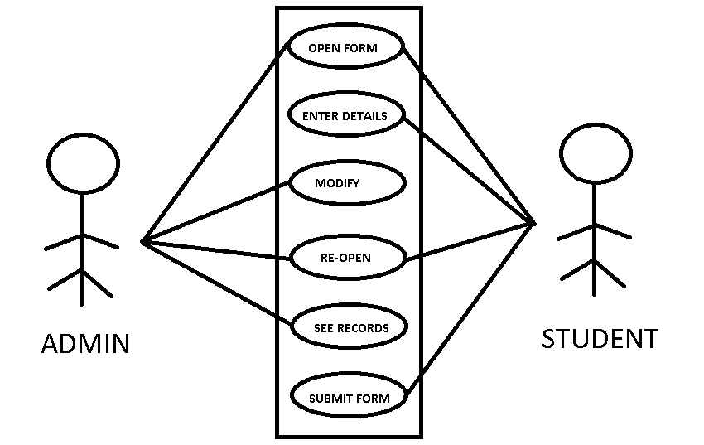
Use case Diagram
S. B. Jain Institute of Technology Management and research
5

Slide 6
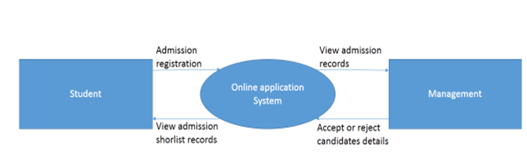
Sequence Diagram
S. B. Jain Institute of Technology Management and research
6

Slide 7
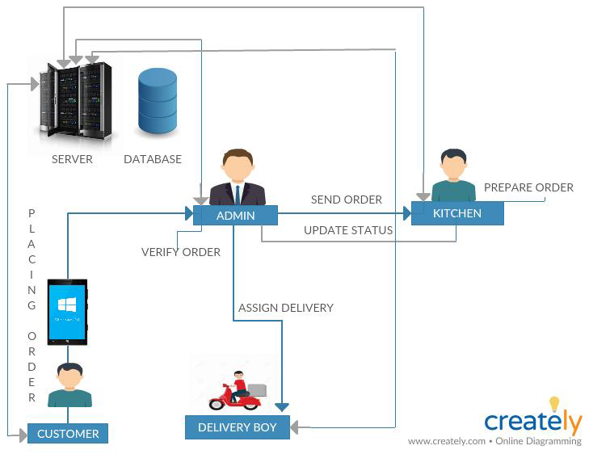
System Architecture
S. B. Jain Institute of Technology Management and research
7

Slide 8
Technology to be Use
Front End:
HTML,CSS
IDE: Visual Studio Code
Hardware used:
Computer (1 GB RAM (32-bit) ,
available Hard disk space (32-bit))
Mouse
Keyboard
S. B. Jain Institute of Technology Management and research
8

Slide 9
Modules
Student Module: This module is for new students where student can register their admission details by entering their profile information, qualification details,etc.
Admin Module : Here management has rights to accept or reject short listed student record after interview process.
S. B. Jain Institute of Technology Management and Research
9

Slide 10
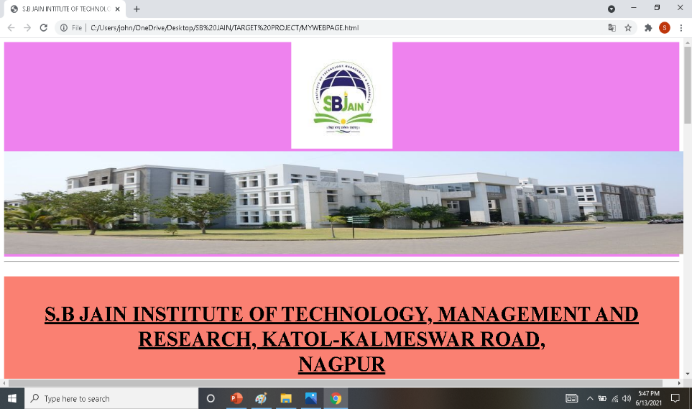
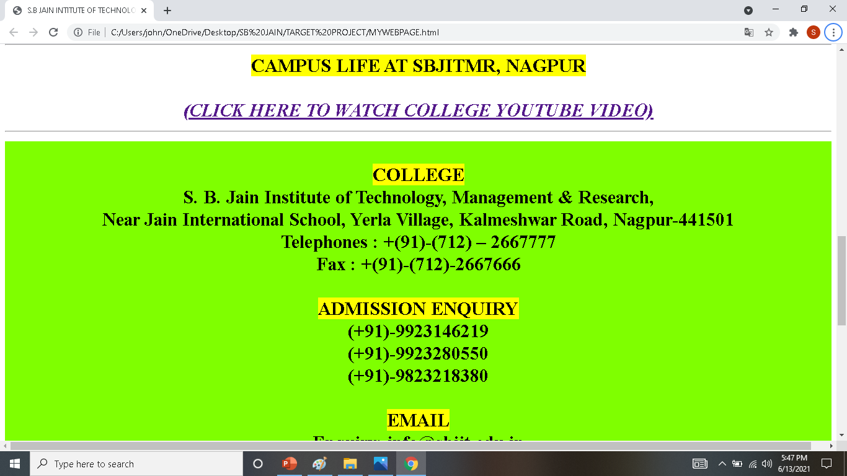
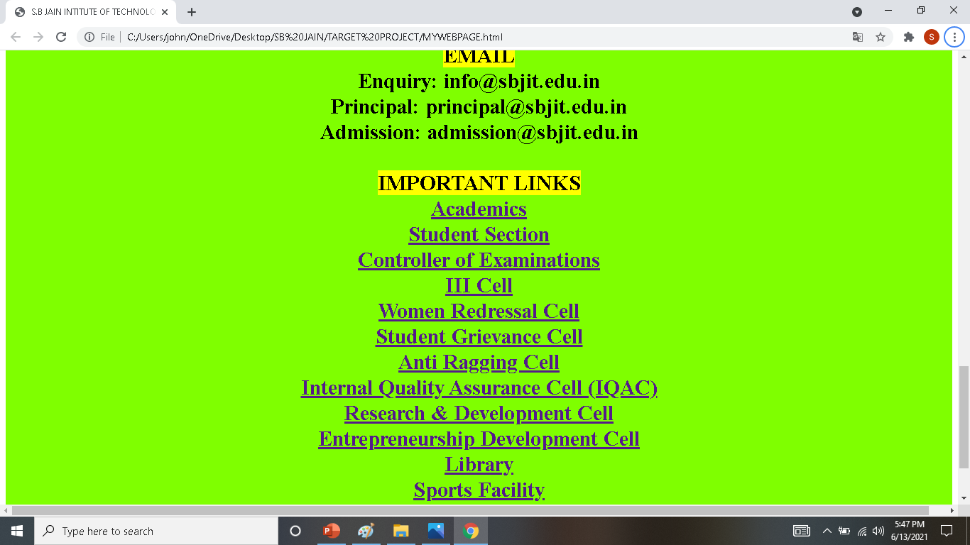
Screen Shots
COLLEGE WEBSITE
S. B. Jain Institute of Technology Management and Research
10

Slide 11
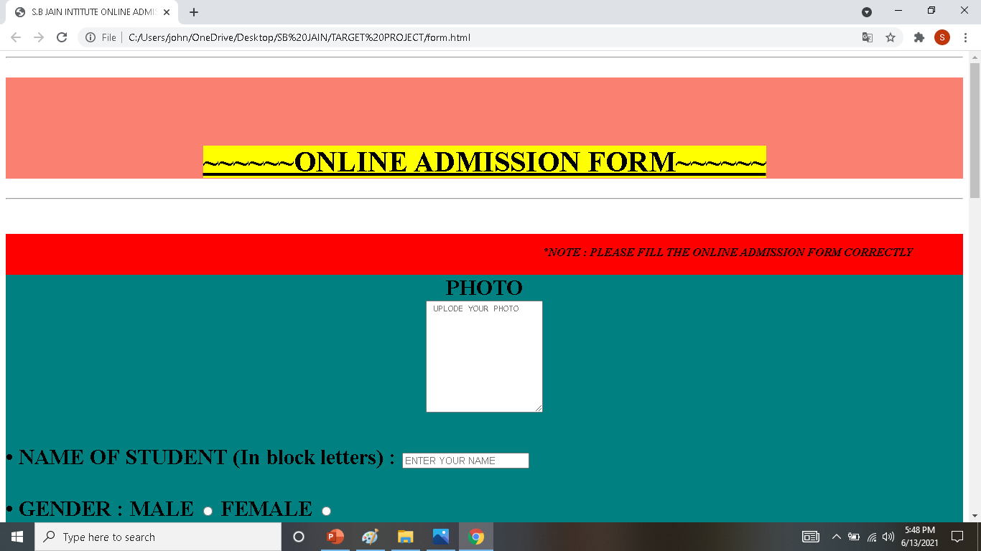
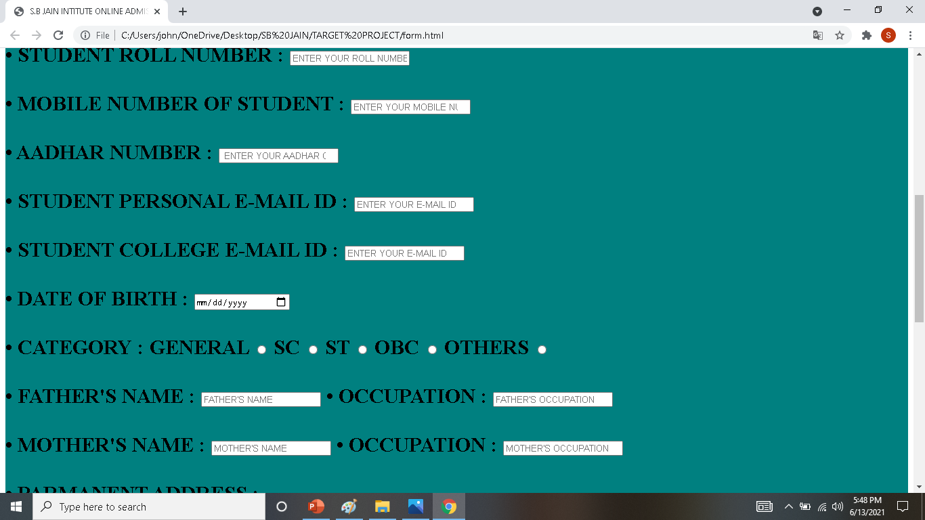
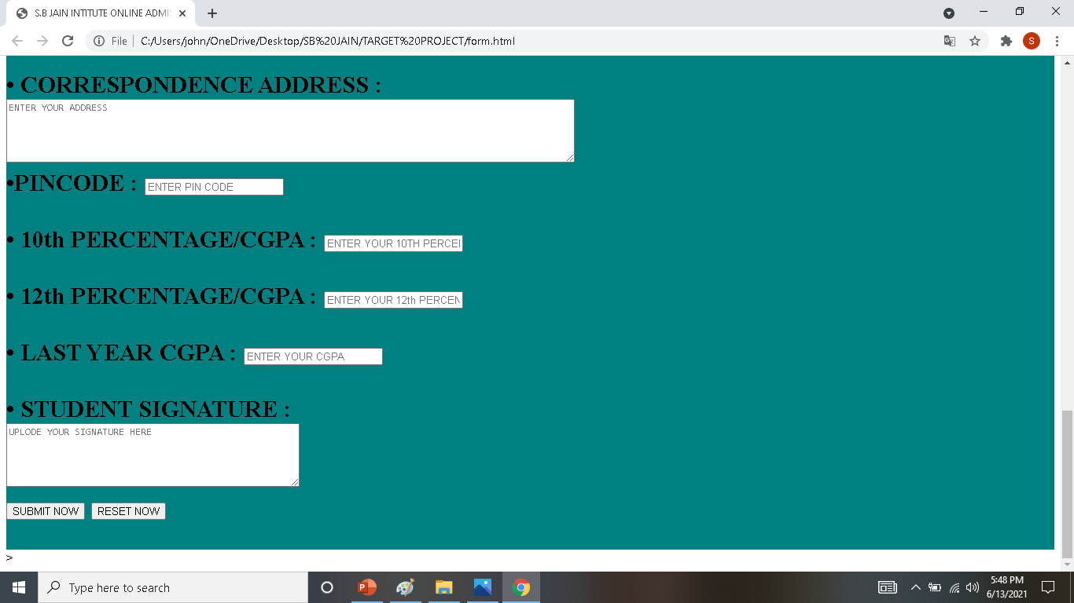
COLLEGE ADMISSION FORM

Slide 12
Advantages
The aim of the proposed system is to address the limitations of the current system. The requirements for the system have been gathered from the defects recorded in the past and also based on the feedback from users of previous metrics tools. Following are the objectives of the proposed system:
Reach to geographically scattered students
One of the important objectives of the admission system is communicate with all the students scattered geographically.
Reducing time in activities
Reduce the time taken process the applications of students, admitting a student, conducting the online examination, verify student marks, and send call letters to selected students.
Centralized data handling
Transfer the data smoothly to all the departments involved and handle the data centralized way.
S. B. Jain Institute of Technology Management and Research
12

Slide 13
Works 24 X 7:
Minimizes time of processing - Because of no time limits, institutes admission process time is reduced. Institutes can publish their merit list lot earlier than they could have done manually following the traditional way.
Maximizes Availability – As it is online admission form, it allows candidates to fill application form at their convenient time.
Only Eligible Candidate Can Apply :
Minimizes Data Redundancy - Checks can be provided so that only eligible candidates can apply. Besides, the candidate data is to be entered only once.

Slide 14
References
Websites:
https://projectworlds.in
https://www.codewithharry.com
S. B. Jain Institute of Technology Management and Research
14

Slide 15
CONCLUSION
As it was already explained in Chapter one that the major objective of this study is to design and develop an Online Admission System for Institute. The prototype which was developed that is very helpful to the admission department as well as the perspective students. This Online Admission System will bring the enhanced interaction between them.
In brief, this web-based admission system is a user-friendly, cost effective web application which resolves rather complicated tasks of a graduate admission office.

Slide 16
FUTURE SCOPE
The online admission system prototype which was developed is effective in a way that it will automate and make online admission instead of manual. Yet some areas in this study not explored in detail due to time constraint. Some of them are given below in future the possibilities of work to be carried out in this system
The payment system can be increased by using the original merchant account for credit card holders.
2. The admission offer letter can be sent online when student is admitted to the
university.
3. Student can be assigned academic coordinator to advice them after admission
to avoid problems of students facing for coming university and choosing
subjects.
4. The admission system security in login can be increased by using CAPTCHA.
5. The System can send the confirmation or information by SMS to cell phone of
candidates.

Slide 17
Thank You !!!

